Slide 1
Arduino project
On proteus platform
CSE 316
University of Asia Pacific Department of CSE
Course teacher : Abdullah Al Omar
(Lecturer)

Slide 2
Project Name: Party light
Name : | Niamul Hasan
Semester: | 3.2
Section : | A1

Slide 3
Equipment for the projects
Arduino UNO
LEDs (12 piece)
Switch (2 piece)
Resistor (POT 14 piece)
VCC-Power source(2 piece)
GND-Ground(3 piece)

Slide 4
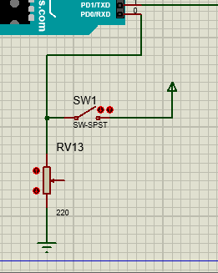
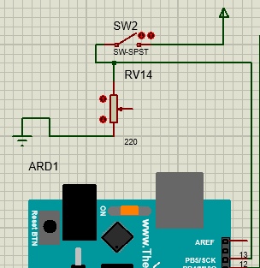
Now About the Project
Functionality change switch
Power switch

Slide 5
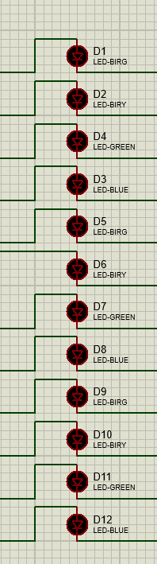
Functionalities of LEDS
2 types of functionalities
Up-down , All functionality

Slide 6
Functionalities of LEDS
Functionality 1(both switch is on)
Up down functionality
Light power ON
Light power OFF
Light power ON
Light power OFF

Slide 7
Functionalities of LEDS
Functionality 2(Power switch is ON Functionality change switch is OFF)
All functionality
Blink
Blink
ON from up ON from bottom
Blink
Blink
Blink
Blink
Light power ON
Light power OFF
Light power ON
Light power OFF

Slide 8
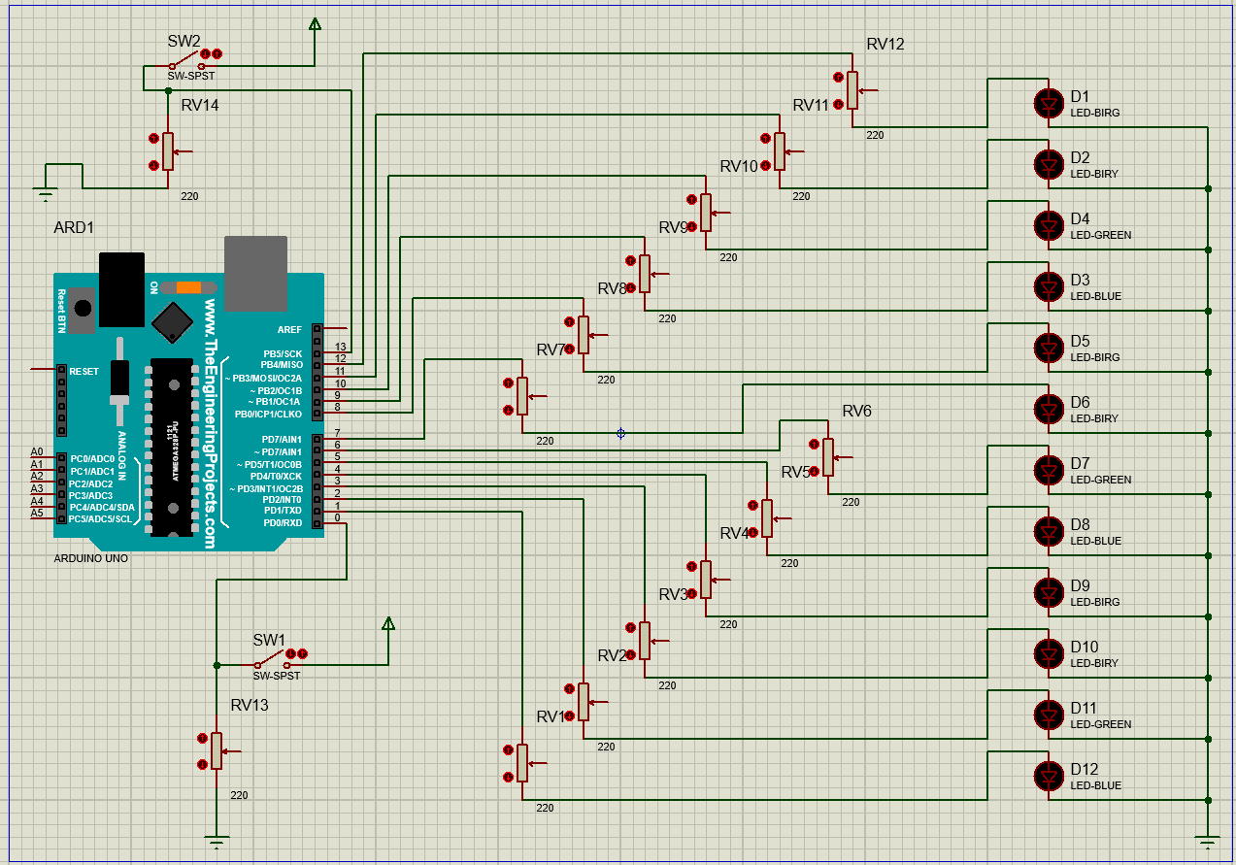
Circuit diagram
LEDs
Power up switch
2types of functionalities
If on: up-down

Slide 9
Thank you

